Slide 1
How to Increase Revenue?
Cyclistic : Casual Riders VS Annual Members
Presented by - Rishabh Gupta
Date Updated- 13.03.23

Slide 2
Contents
Business Task - Ask
Data source description - Prepare
Data cleaning and manipulation - Process
Insights from the analysis - Analyze
Key findings - Share
Recommendations - Act

Slide 3
The problem
Company
Context
Problem statement
Cyclistic, a bike-share company in Chicago,that features more than 5,800 bicycles and 600 docking stations.
Need recommendations to increase revenue backed up with compelling data insights and professional data visualizations.
Design marketing strategies aimed at converting casual riders into annual members by analyzing the Cyclistic historical bike trip data to identify trends.

Slide 4
Challenges deep-dive
Challenge 1
Challenge 2
Challenge 3
Members VS Customers
– How do annual members and casual riders use bikes differently?.
Customer to Member
– Why would casual riders buy annual memberships?
Increase conversion
– How can Cyclistic influence casual riders to become members?

Slide 5
The Stakeholders
CEO
Wendy Writer
Dir. of Marketing
Ronny Reader
Executive I
Executive II
Executive III
Perry Presenter
Vinny Viewer
Molly Maker
Junior Data Analyst
Rishabh Gupta

Slide 6
Data Source
Cyclistic’s historical trip data from their system database

Slide 7
Data Cleaning & Manipulation

Slide 8
Examined the data in Excel and chose to do analysis with SQL in BigQuery
Renamed the files by year and month and used UNION operator to combine them into one table.
Cleaned the data by renaming the columns properly.
Checked for duplicate rows in the dataset and found one repeated ride_id, decided to leave it as it is.
Added 2 new columns: "ride_length_minutes" and "day_of_week", and included only valid columns.
Saved the result as a new table titled "Cyclistic-N".

Slide 9
Deriving Insights from Data

Slide 10
Find the average, minimum, and maximum ride lengths for all rides.
Filter out negative ride lengths that are invalid.
Calculate average, minimum, and maximum ride lengths for casual riders and member riders.
Calculate the average ride length for each day of the week, for both members and casual riders.
Determine the number of rides taken by members and casual riders.
Check if there are differences in the type of vehicles chosen.
Identify the top 10 most frequented start and end stations by riders.

Slide 11
Key Findings
Visualisations

Slide 12
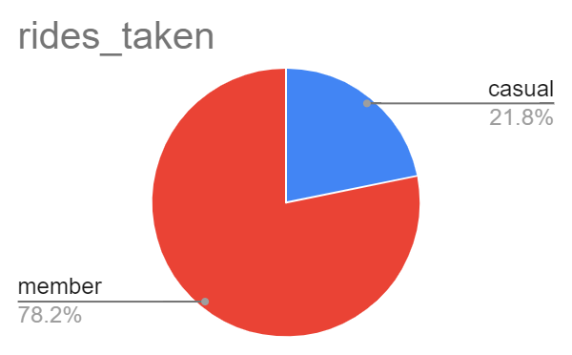
Member customers take rides more often than casual customers. They consists around three-fourth of the total customers

Slide 13
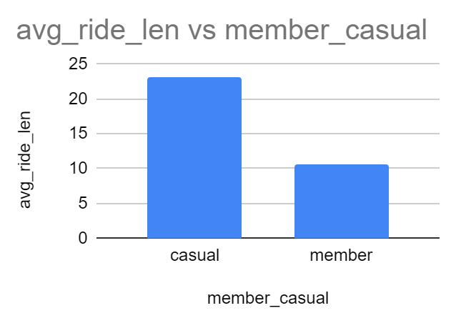
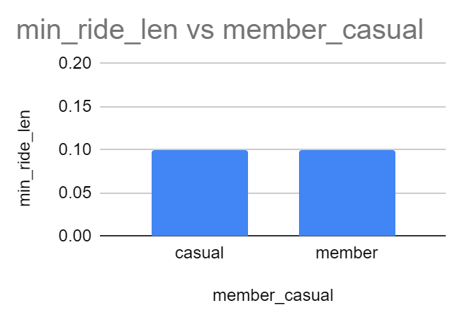
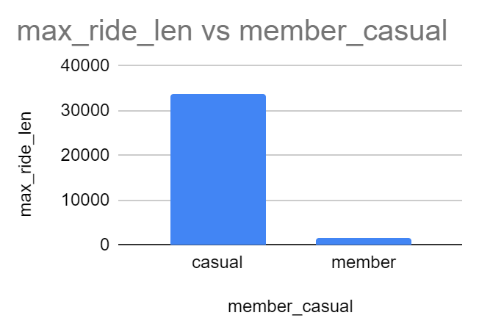
avg _ride_len , min_ride_len , max_ride_len comparison between casual and member riders.

Slide 14
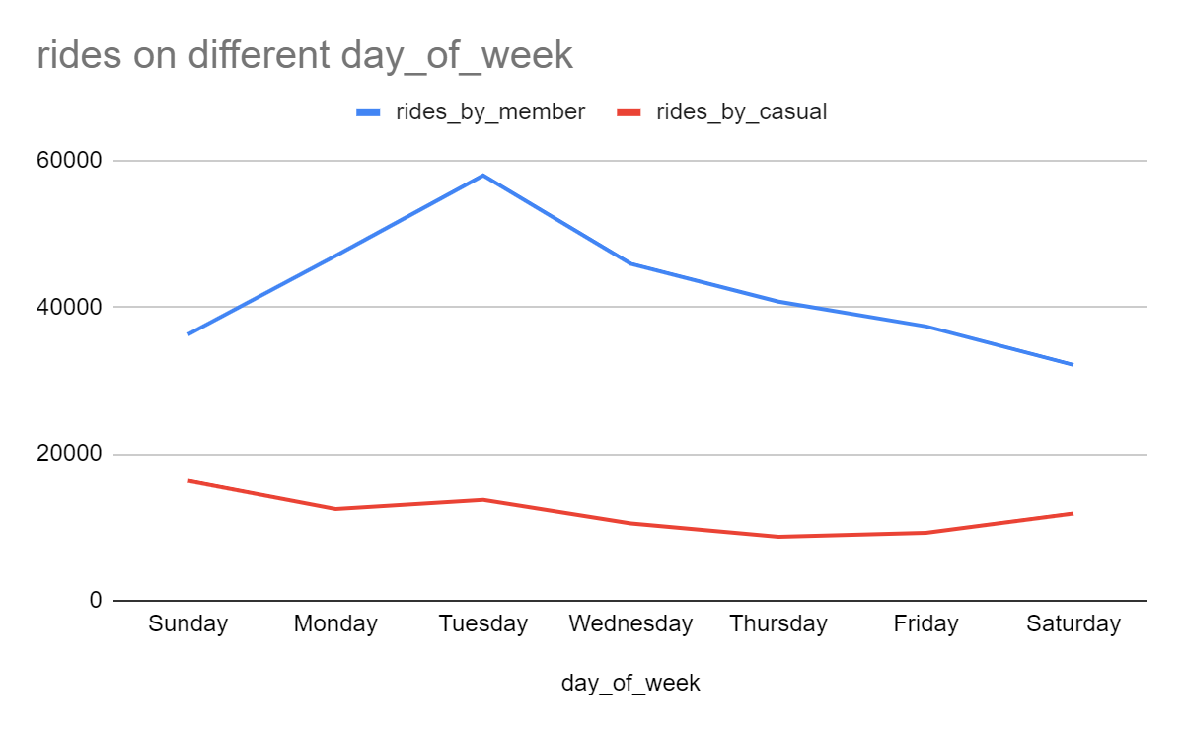
Number of rides taken by members and casual on different days of the week.

Slide 15
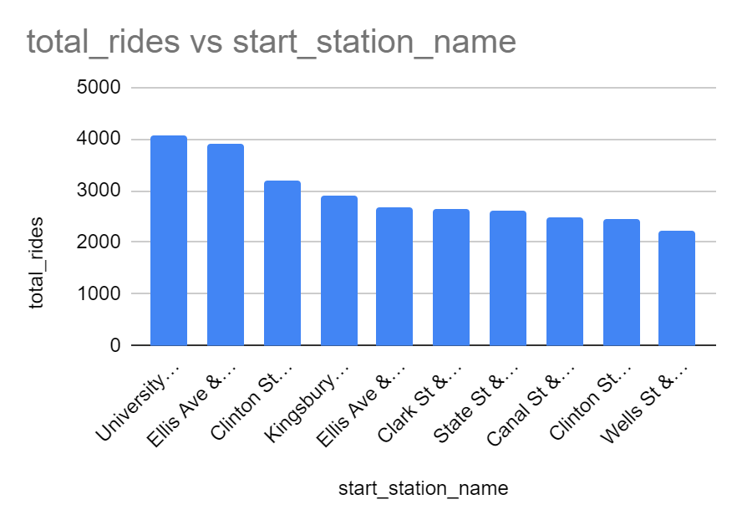

Most frequently visited start stations and end stations by riders.

Slide 16
Recommendations
It is usually seen that casual riders tend to take longer rides. By giving cashback benefits on longer rides with member subscription may tempt casual riders to buy the subscription.
One of the viz also shows that casual riders tend to ride on weekends. Giving weekend offers on member subscription can be a good strategy too.
The busiest stations tend to have more riders, advertisements on member subscription on those stations can help the company convert more casual riders.

